Slide 1
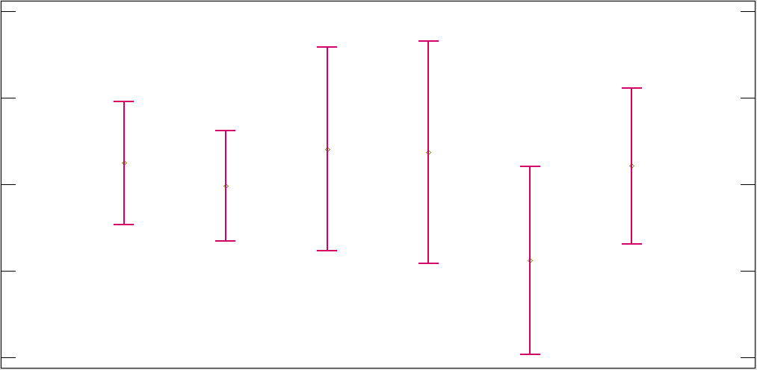
Means & 95% of Fisher´s LSD
17,9
Unfavorable
15,9
Favorable
Very
favorable
YearsCode
13,9
11,9
Indifferent
Unsure
Very
unfavorable
9,9
Blockchain

